Slide 1
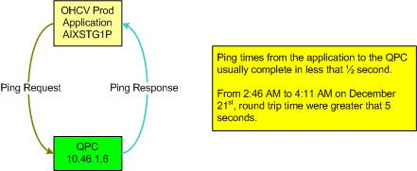
Dept
MAP Stamping
IR #
1423857
OHCV QPC Unhealthy
Rev. 1 8/09 JS/DC
Phase 1
X
Completed By:
Adam Kendell Incident Date: 12/21/2011
Phase 2
Problem:
From 2:46AM to 4:11AM, pings from the application to the QPC were taking longer than 5 seconds to make the round trip.
Background: We just recently moved the application to another database server to lessen the impact of our daily maintenance window.
Root Cause: Unknown at this time
Management Viewpoint:
Knew this was isolated to the Stampstorage application.
Detailed Impact: Stamping department reported 64 minutes of downtime.
Line #
N/A
Shift
B
Plant:
MAP
Counter Measure Category | Countermeasure Description | Schedule (when is the task scheduled to be completed or was completed) | Who (is responsible for the fix? Team or person)
Quick Fix
TCM:
PCM:
Identified Themes

Slide 2
